Slide 1



Lesson 2: Introduction to Big Data and Analytics
November 2018

Slide 2
Understand the key concepts and drivers behind big data and analytics.

Slide 3
Big Data Overview

Slide 4
What is Big Data ?
Collection of data sets so large and complex that it becomes difficult to process using on-hand database management tools or traditional data processing applications. The challenges include capture, storage, search, sharing, analysis, and visualization
Characterized by Four V-s:
Volume
Variety
Velocity
Veracity
Notes:
Traditional DB such as Relational DB can handle storing large amount of data, but when talking about sensors data – that’s the challenge spark is here to answer
Most of the designs combine both Big Data and Relational DB

Slide 5
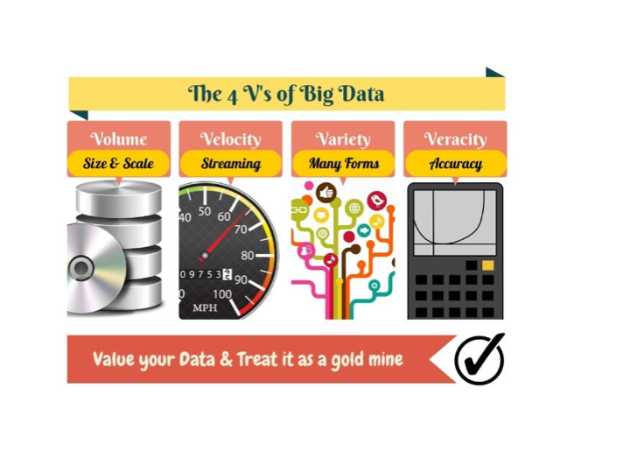
Notes:
Volume- is the size of the data
Velocity – Speed the data measured by byte/transaction per second
Variety – Not always structured
Veracity – Not always in order, old comes after new, some data is garbage
Value- is there really a need for this data, sometimes it can be overhead

Slide 6
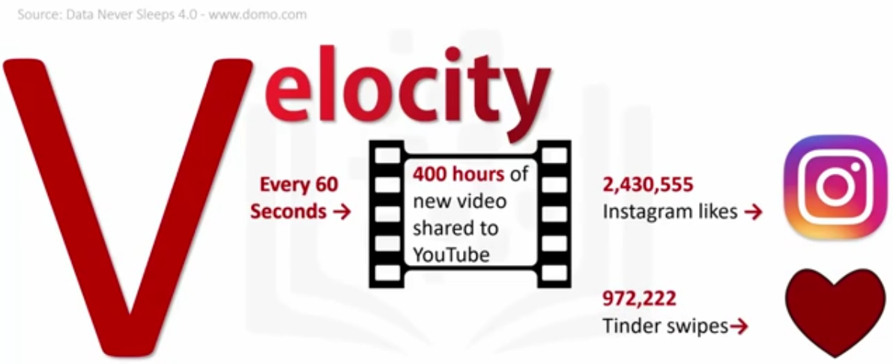
Velocity

Slide 7
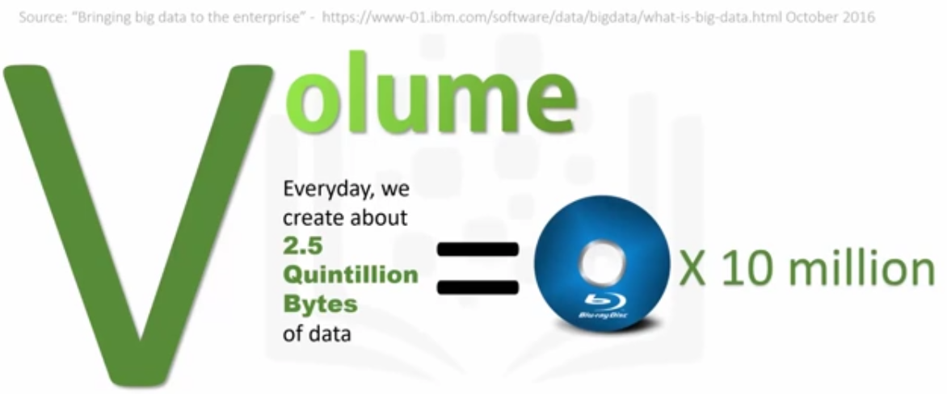
Volume

Slide 8
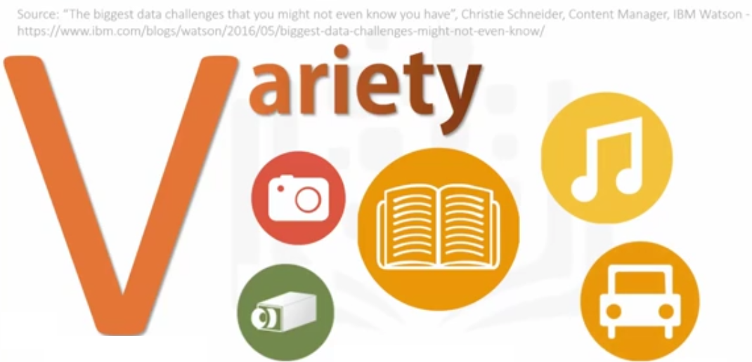
Variety

Slide 9
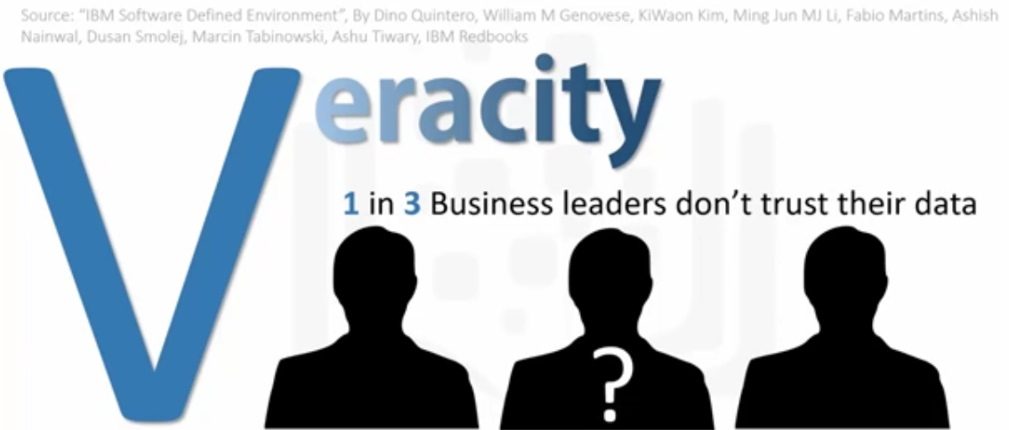
Veracity

Slide 10
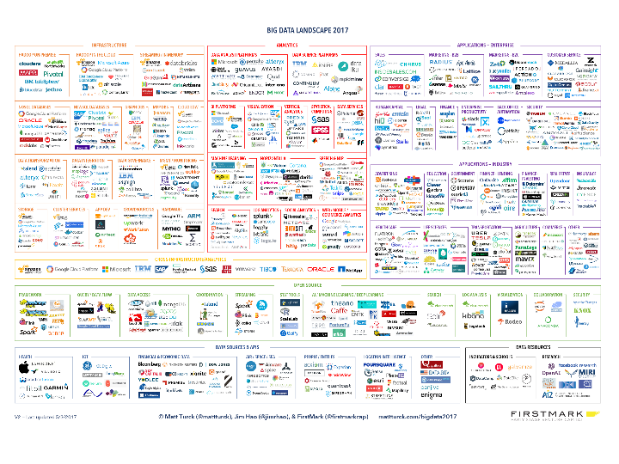

Slide 11
Share nothing vs. Share everything
Share nothing | Share everything
Many Servers | Many processing engines
Data is spread on many nodes | Data is located on a single storage
Joins are problematic | Efficient Joins
Very Scalable | Limited Scalability
Notes:
99% of big data technology will use Share nothing – Many servers with same resources, applications can use all the machines together without sharing resources between the machines
Oracle is example for Share everything – sharing all resources (CPU,Memory,Storage,Network) of the machine for specific application

Slide 12



Knowledge Discovery Engine
Data Warehouse
BI Tools and Dashboards
High Volume Distributed File System
MapReduce code separates valued data, then sent to via specialized adapters to Data Warehouse
Real-Time Analytics and Recommendations
Location & User Profile
Recommend
Website Logs & Data
NoSQL DB

Slide 13






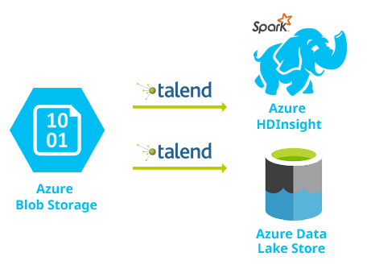






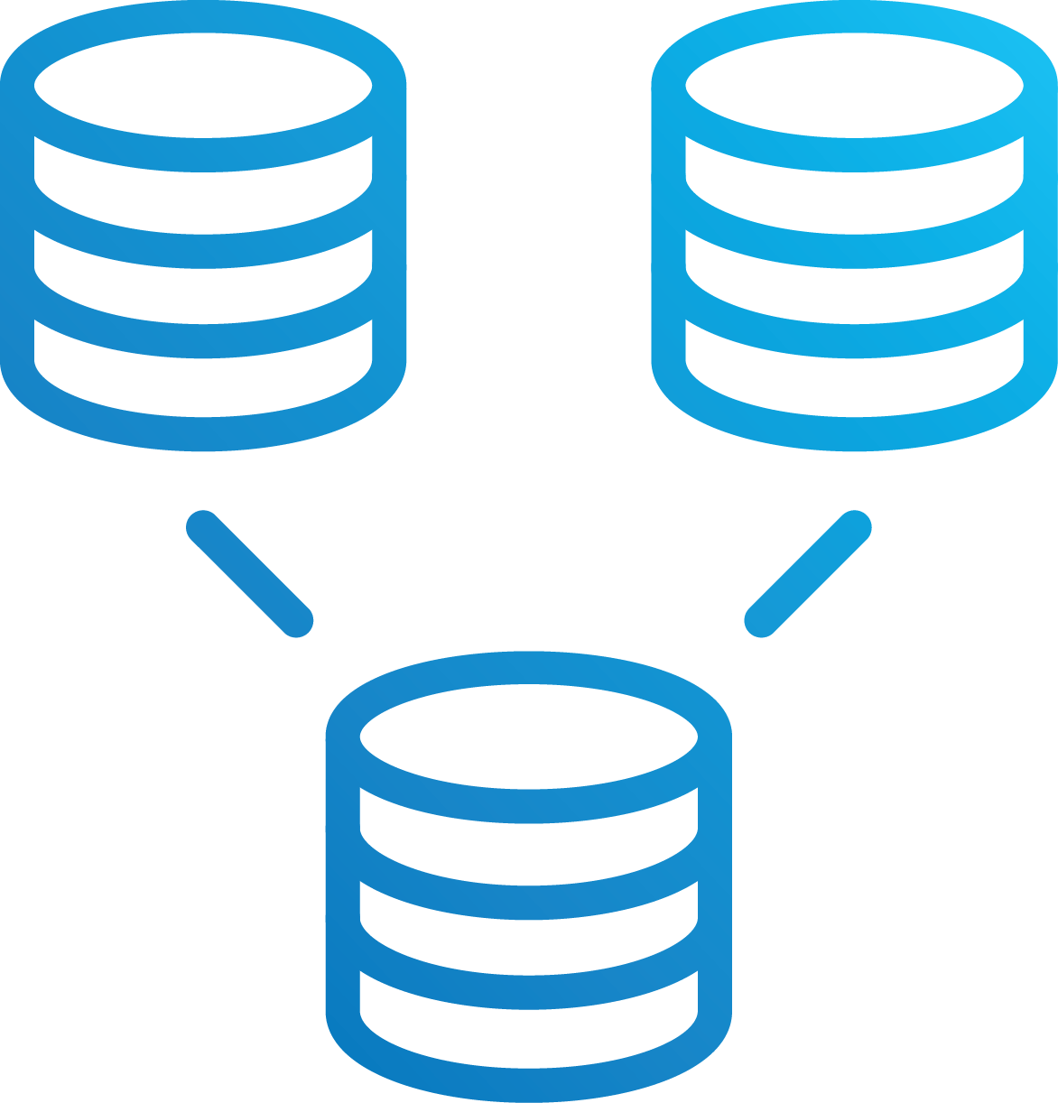









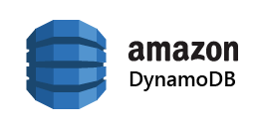






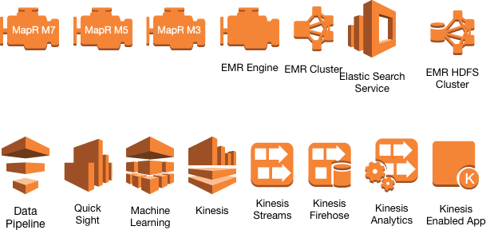


LAMBDA ARCHITECTURE
DATA SOURCES
DATA CAPTURE/ LAYER
BATCH LAYER
STORAGE
BATCH ANALYTICS
APPLICATIONS
Files
FILES
Public Cloud (GCP)
EMR
MESSAGE BUS
Public Cloud (AWS)
Capture
Public Cloud (Azure)
DATABASES
MANAGEMENT LAYER
SPEED LAYER
EVENT-DRIVEN ANALYTICS
STORAGE & CACHE
Private Cloud
Events
Serverless, e.g. AWS Lambda
EVENTS
Kafka consumers
Event Hubs
Google Pub/Sub
CDC, Message Bus
Kinesis Enabled App
Azure Cosmos DB
SENSOR DATA
Trigger
SOCIAL
CONTROL LAYER
(Management, Orchestration, and Security)
Notes:
Lambda architecture

Slide 14
Big Data
Kappa Architecture
Broker
(messaging)
Storage Tier
Views, Apps…etc
Stream Processing Tier

Slide 15
Big Data
From batch to streaming + batch
Batch & Map/Reduce
Lambda Architecture
Kappa Architecture
2015
2013
Everything is a Stream and
can be Re-Processed
History
Velocity + Volume
(Two-tiered analytics combination)
Volume-oriented

